Slide 1
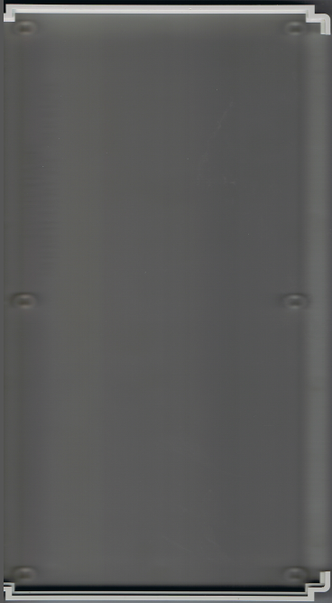
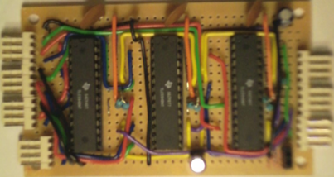
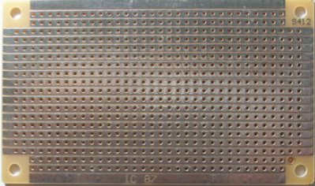
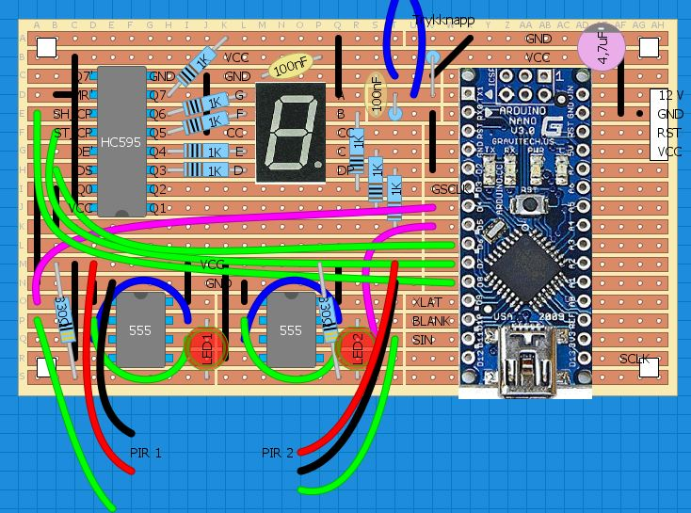
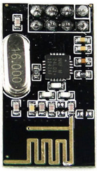
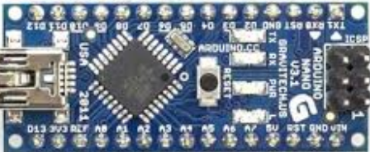
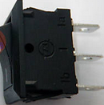
Mot
døra
WiFi modul (senere)
LED 2
SYS
11
LED 3
SYS 12
LED 4
LED 1
LED 5
LED 7
SYS 21
LED 8
SYS 22
LED 9
SCLK
XLAT
SIN1
LED 6
BLANK
RST
5V
LED 10
GSCLK
GND
12V
LED 12
SIN2
SOUT1
SYS 31
LED 13
SYS 32
LED 11
SIN3
SOUT2
Av/på bryter
Power plugg
OPP
OPP

Slide 2
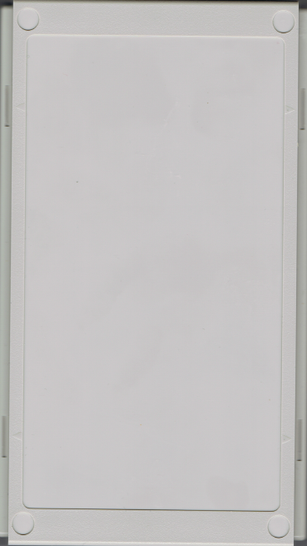
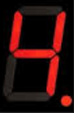

Slide 3
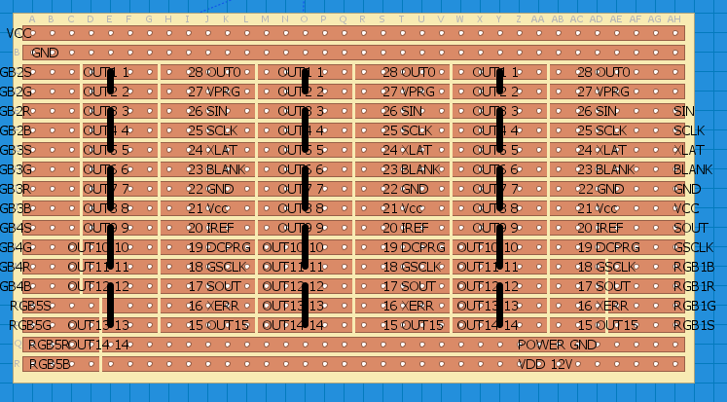

Slide 4
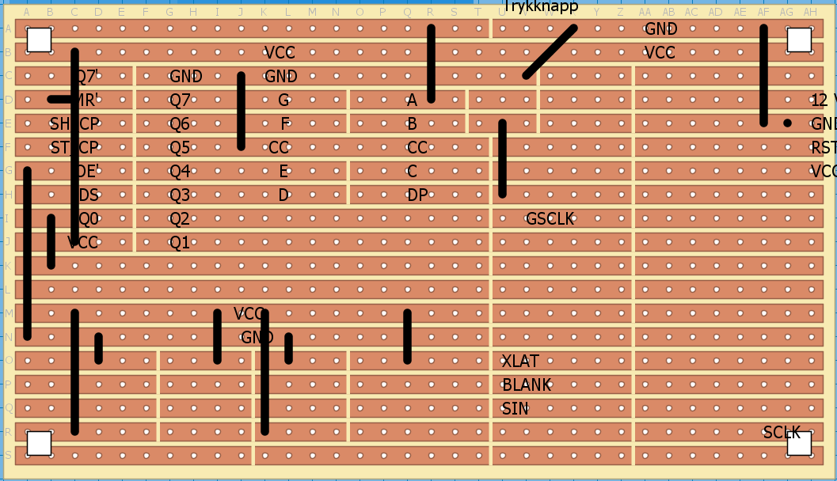

Slide 5
